Slide 1
TITLE : CUSTOMER SUPPORT CHATBOT WITH ML BASED ON HEALTHCARE
PIP2001 Capstone Project
VIVA-VOCA
Batch Number: CSG-07
ROLL NO | NAME
20211CSG0048 | MAMATHA S
20211CSG0006 | NITHYA T M
20211CSG0025 | PRACHI
20211CSG0028 | NARMADA RADHIKA J S
Under the Supervision of,
Dr. Leelambika K V
Assistant Professor
School of Computer Science and Engineering
Presidency University
Name of the Program: B.Tech [Computer Engineering]
Name of the HoD: Dr. SAIRA BANU ATHAM
Name of the Program Project Coordinator: Dr. MANJULA H M
Name of the School Project Coordinators: Dr. L SHAKKEERA / Dr. MYDHILI NAIR / Dr. SAMEERUDDIN KHAN

Slide 2
Introduction
Mental health concerns such as depression, anxiety, and stress have escalated into significant global issues, affecting millions of individuals across all demographics.
According to the World Health Organization (WHO), over 264 million people suffer from depression alone, with young adults aged 15 to 29 being particularly vulnerable.
Despite increasing awareness, various barriers hinder access to timely and effective mental health care.
These include societal stigma, a shortage of qualified mental health professionals, long waiting times, and the high costs associated with traditional healthcare services.
These challenges are especially pronounced in low- and middle-income regions, where healthcare infrastructure is often limited.

Slide 3
Literature Review
Paper Title | Journal/ Conference(Year) | Advantages | Limitations
Desiree Bill et al., “Therapy Chatbot applications”[15] | Desiree Bill, Theodor Eriksson.(2023) | Fine-tuning an LLM through Reinforcement Learning from Human Feedback (RLHF) has been instrumental in developing a highly effective psychological AI chatbot for therapy. | Limited ability to generalize, absence of human empathy and expertise, ethical challenges and a restricted understanding of context
2. Luigi De Angeliset al., “ChatGPT and rise of LLMs: The new AI driven infodemic threat in public health”[12] | National Research Council, Italy (2023) | There is a risk of generating inaccurate information that may seem reliable, as well as the potential for creating deepfake content. | The presence of biased datasets in LLMs and OpenAI’s Lack of sufficient privacy information
3. Enkeleja Kasneciet al., “ChatGPT for good? Opportunities and challenges of LLMs for education”[8] | Technical University of Munich, Germany (2023) | Challenges in the applications of LLMs in education and how to address them. | A time-intensive process and ethical considerations

Slide 4
Literature Review
Paper Title | Journal / Conference (year) | Advantages | Limitations
4.Volk Hartmann et al., “Chatbot Modules for Long Open-domain Conversations” | University of Wisconsin-Madison (2022). | MPC, which uses a pre-trained LLM, is more effective than the fine-tuned BB3-30B | We expect that a modular approach could be effective for other languages, given the availability of a capable language model.
5. Ben Niu.Et al., Conversational Ai and Academic Integrity | Dwivedi et al(2021) | Ethical culture , ethical awareness, and self confidence in making ethical decisions. | Limited empirical research, inadequate exploration of outcomes and the effect of different factors
6. AI leveraging LLMs for public health intervention | NAVER AI labs, France (2023) | Five health metrics were collected and summarized for social workers. | A limited sample size and bias in the sample

Slide 5
Research Gaps Identified
The healthcare chatbot sector has seen considerable progress in recent years, but there remain significant research gaps that limit their widespread adoption and effectiveness.
One of the primary challenges is the inadequate integration of domain-specific knowledge, which impacts the chatbot's ability to deliver precise medical information.
Many existing solutions rely on general datasets, which restrict their utility in specialized fields like otolaryngology (ENT).
The main approaches to healthcare chatbots are as follows:
1 Rule-based Systems
2 Retrieval-based Models
3 Generative Models
4 Cloud-based Solutions
5 Identified Research Gaps

Slide 6
Proposed Method
The Medical Chatbot integrates advanced technologies to provide accurate and efficient healthcare guidance. Key components include:Natural Language Understanding (NLU): Powered by SBERT for understanding user intent and generating semantic embeddings for medical queries.
1. Dataset The knowledge base is derived from medical textbooks and research papers, ensuring reliable, up-to-date information. Preprocessing techniques generate vector embeddings for efficient semantic matching.
2. Workflow User Query Submission: Users interact via a user-friendly web interface.Query Processing: Queries are cleaned, tokenized, and embedded using SBERT.Semantic Search: Pinecone retrieves contextually relevant data using cosine similarity.Response Generation: Structured, user-friendly responses are generated with template-based methods.Response Delivery: Flask ensures smooth, responsive communication with users.
3. Technologies NLU: Captures semantic meaning of user inputs using SBERT.Pinecone: Enables scalable, high-performance vector search.Flask: Manages APIs and real-time interactions.LangChain: Handles dynamic multi-turn dialogues, ensuring context-aware conversations.

Slide 7
Objectives
The ENT Medical Chatbot is designed to offer an efficient, reliable, and user-friendly solution tailored to the specific needs of the otolaryngology (ENT) field. Below is a detailed breakdown of the key objectives, including implemented features and examples.
1. Provide Accurate and Domain-Specific Responses
2. Enable Contextual Understanding of User Queries
3. Ensure Scalable and Maintainable System Architecture
4. Provide a User-Friendly Interaction Experience
5. Enable Secure Handling of Sensitive Data
6. Foster Collaboration and Continuous Improvement
7. Ensure Efficient Retrieval of Information

Slide 8
System Design and Implementation
The design and implementation of the ENT Medical Chatbot are carefully structured to prioritize robustness, scalability, and user-oriented functionality. Below is a detailed overview of its components, features, and implementation strategies.
System Architecture To design a scalable and efficient architecture that separates user interaction, data processing, and knowledge retrieval for optimal performance.
Data Flow Ensure a smooth interaction between user input and the chatbot’s response generation process.
Data Flow Ensure a smooth interaction between user input and the chatbot’s response generation process.
Key Modules Modularize the system to enhance scalability, maintainability, and reusability.
Implementation Techniques Adopt best practices in coding, testing, and deployment to ensure system reliability and robustness

Slide 9
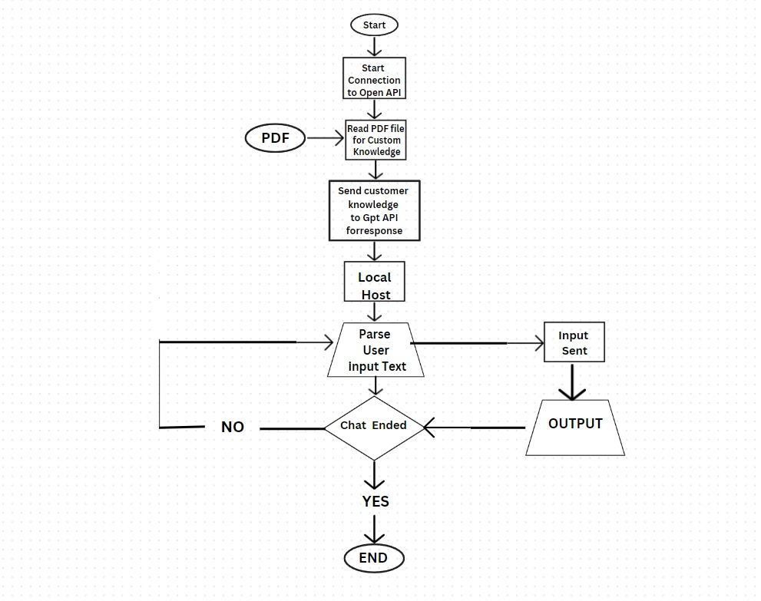
Architecture

Slide 10
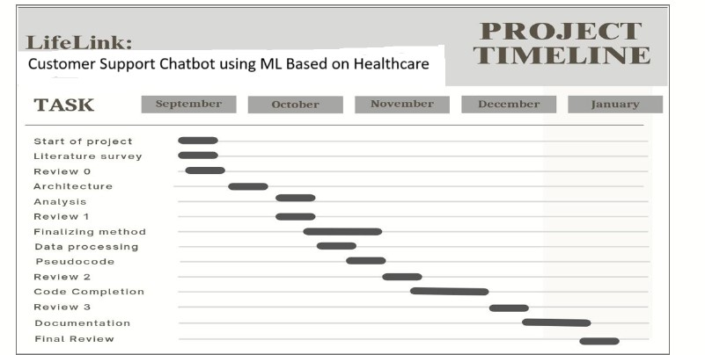
Timeline of Project

Slide 11
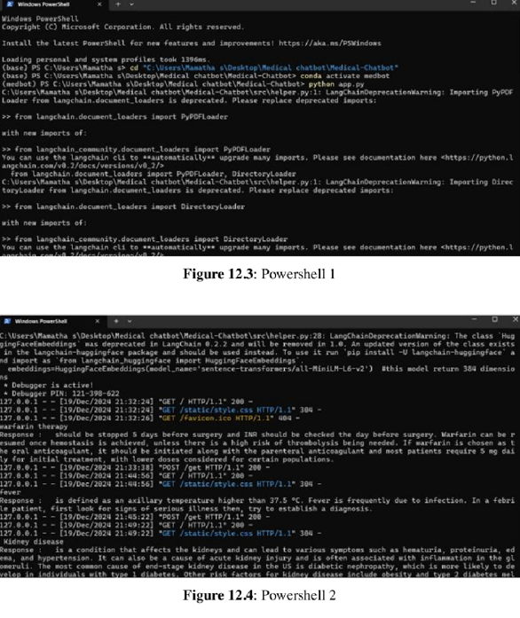
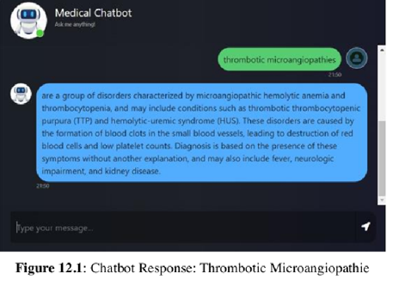
Results & Outcomes Obtained

Slide 12
Conclusion
The Medical Chatbot project aimed to enhance healthcare accessibility by leveraging AI, cloud technologies, and user-centric design. Built using Python and hosted on AWS, the chatbot integrates a curated medical knowledge base and advanced semantic search capabilities powered by large language models (LLMs) to deliver accurate and relevant responses. Its modular architecture ensures scalability and maintainability, while the Flask-based interface provides a user-friendly experience suitable for individuals with diverse technical expertise. The project successfully achieved its objectives, including the development of an efficient knowledge base, seamless integration of semantic search, and deployment on a scalable cloud platform. Key accomplishments include accurate data retrieval, robust chatbot functionality, and open-source availability to foster collaboration. Despite its success, the project faced challenges such as limited data sources and difficulties in handling complex queries, highlighting the need for iterative improvements. Future directions involve expanding data sources, enhancing NLP capabilities, integrating real-time health monitoring through wearable devices, and supporting multiple languages to increase accessibility. This project underscores the transformative potential of AI in healthcare by bridging gaps in medical information and empowering users to make informed health decisions.

Slide 13
References
[1] Eunkyung Jo, Daniel A. Epstein, Hyunhoon Jung & Young-Ho Kim. (April 2023). “Understanding the Benefits and challenges of Deploying Conversational AI Leveraging Large Language Models for Public Health Intervention”. Human Factors in Computing Systems [Online].
Available: https://doi.org/10.1145/3544548.3581503.
[2] Luigi De Angelis Francesco Baglivo, Guglielmo Arzilli, Gaetano Pierpaolo Privitera, Paolo Ferragina, Alberto Eugenio Tozzi & Caterina Rizzo. (April 2023). “ChatGPT and the rise of large language models: The new AI-driven infodemic threat in public health”. Digital Public Health [Online]. Available: https://doi.org/10.3389/fpubh.2023.1166120.
[3] Shan Chen, Benjamin H. Kann & Michael B. Foote. (2023). “AI Chatbots for cancer treatment”. JAMA Oncol [Online]. DOI:10.1001/jamaoncol.2023.2954.
[4]Customer Support Chatbot Using Machine Learning https://www.researchgate.net/publication/343980800_Customer_Support_Chatbot_Using_M achine_Learning [4] Dmitry I. Mikhailov. (May 2023). “Optimizing National Security Strategies through LLMDriven AI”, Artificial Intelligence [Online]. DOI: 10.14293/PR2199. 000136.v1.
[5] Deploy Machine Learning Model using Flask https://www.analyticsvidhya.com/blog/2020/04/how-to-deploy-machine-learning-modelflask/
[6] Flask Basic tutorial https://www.tutorialspoint.com/flask/index.htm
[7] Følstad, A., Skjuve, M., & Brandtzaeg, P. B. (2018). Different chatbots for different purposes: Towards a typology of chatbots to understand interaction design. In International Conference on Internet, Springer, LNCS (Vol. 11551, pp. 145-156).

Slide 14
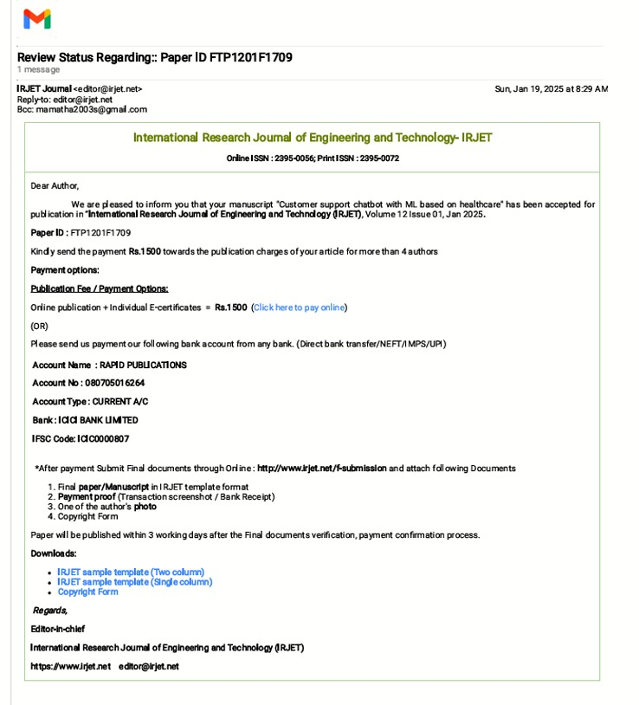
Publication Details

Slide 15
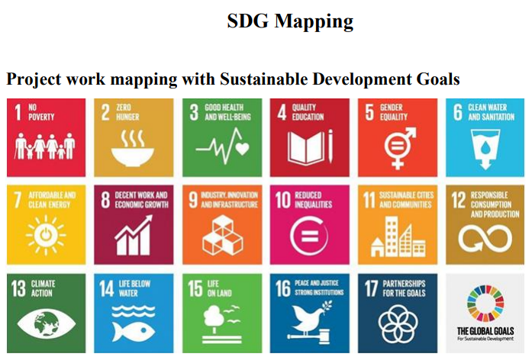
Project work mapping with SDG
SDG 3: Good Health and Well-Being
The chatbot improves healthcare accessibility by offering reliable medical guidance to underserved regions, reducing health disparities.
SDG 4: Quality Education
Serves as an educational tool for medical students and practitioners by offering a vast repository of verified medical knowledge.

Slide 16
Project work mapping with SDG
SDG 9: Industry, Innovation, and Infrastructure
Leverages cutting-edge AI, natural language processing (NLP), and semantic search technologies to revolutionize healthcare delivery.
SDG 10: Reduced Inequalities
Addresses healthcare inequalities by providing medical assistance to remote and underserved regions where healthcare services are limited or absent.
SDG 17: Partnerships for the Goals
Promotes collaborative efforts between technology providers, healthcare professionals, and policymakers to create a unified healthcare framework.

Slide 17
Github Repository Link
https://github.com/mamathas18/Medical-Chatbot.git

Slide 18
Thank You

